Slide 1
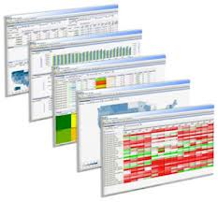
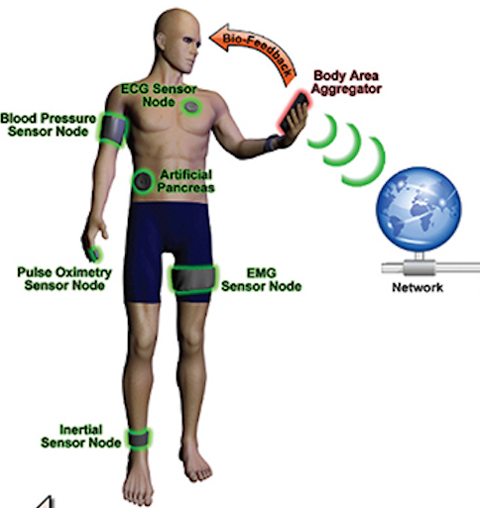
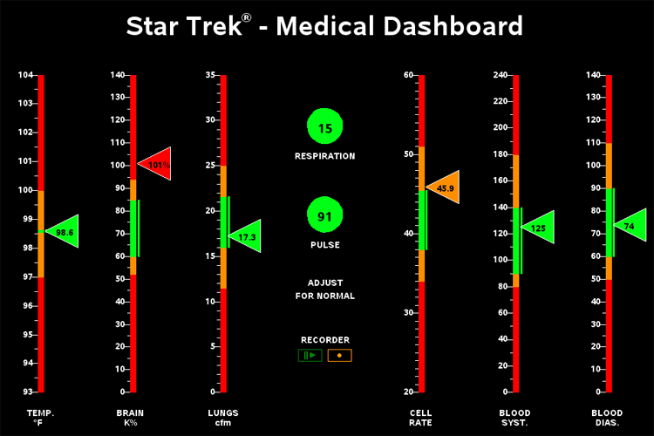
Reports
Patient Monitoring Unit
Management /
Care Team
Translate Questions to analytics
Dashboards
Response (Care / Treatment)
Data Scientist /
Analysts
Managed Big Data Analytics Platform
(Public Cloud or Private Hosted*)
Service Management
Security
Information / Data
Analytics App
Sensing Environment
Data Aggregator
Ingestion / Data management
Algorithms
Environment Sensors
Temperature, Light levels, Air Quality etc….
Real-time
dashboard
Streaming Analytics Engine (optional)
Data Lake
Batch Analysis (Hadoop)
Response (Care / Treatment)
OPTIONAL: - Real-time Analysis of data as it is transmitted to enable real-time response based on key triggers
All data stored for continued analysis, long term store.
Sensors will collect data from both human and environmental signals, these need to be aggregated and ingested into a Data Analytics platform, for analysis and reporting on questions which are being asked of the data.
*Depends on security policy and regulatory compliance

Slide 2

















Home / Mobile AI - “Carl is ok, but you may wish to give him a call”
System AI - “Carl needs Assistance, his stats are ……..”
Family /
Friends
Response
Teams
Mobile AI - “Carl suggest you step outside for some fresh air, maybe you should call your family.”
Mobile AI - “Carl how are you feeling, why don’t you tell me.”
Alexa
Cortana
Analytics Code based on known triggers.
Continued development of analytics based on new data sources
Responses systems maybe tailored to individual levels / trigger.
Siri
Health
Data
Location
Data
Environment
Data

Slide 3
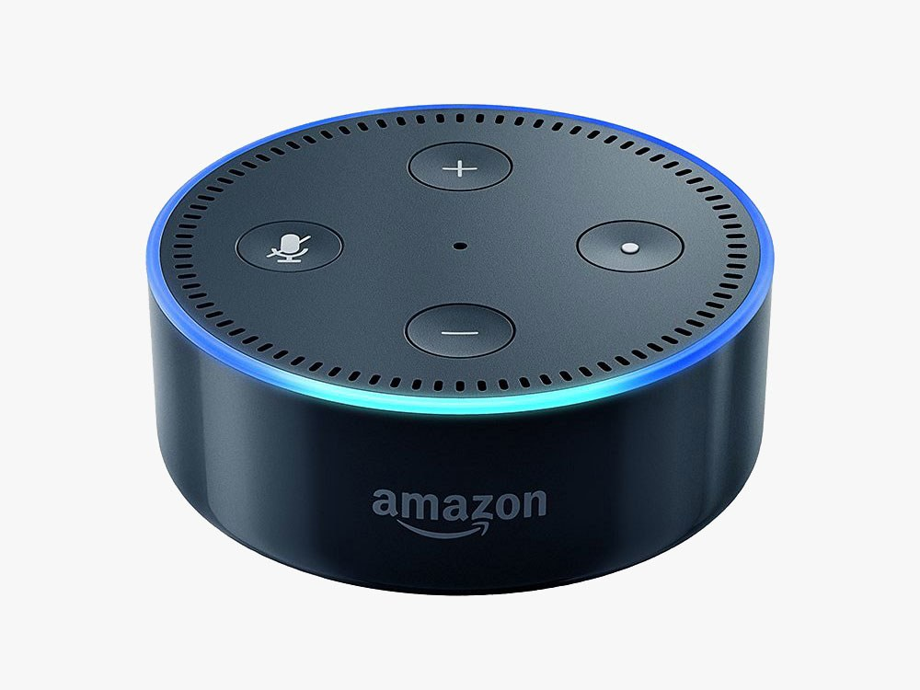

Stage 1 -
AWS Gateway Microservice
Bio Data
API
AWS DB Microservice
Alexa Skill / Cloud
Microservice
Simple Wearables
Create Alexa
Skill
API
Data Collections
Create AWS Lamda Function
AWS Lambda MicroService
Data Analyst creates simple
hypothesis – Temperature Trigger

Slide 4
Stage 2 – Single pain
of Glass
AWS Gateway Microservice
Bio Data
API
AWS DB Microservice
Alexa Skill / Cloud
Microservice
Simple Wearables
Environment Data
API
Create Alexa
Skill
API
Fixed Location Sensors
Mobile Device Sensors
Data Collections
Location
Data
API
Create AWS Lamda Function
Mobile Device
Event planning Calendar Info
AWS Lambda MicroService
Data Analyst creates combined
hypothesis – multiple trigger

Slide 5
Home/Mobile
Biz System
Stage 3 – Increase
Awareness
AWS Gateway Microservice
Alexa
Cortana
Bio Data
API
Siri
AWS DB Microservice
Simple Wearables
Environment Data
API
API Gateway
To AI Services
API
Fixed Location Sensors
Mobile Device Sensors
Data Collections
Location
Data
API
Create AWS Lamda Function
Mobile Device
Event planning Calendar Info
AWS Lambda MicroService
Data Analyst creates simple
hypothesis – Temperature Trigger

Slide 6
Home/Mobile
Biz System
Stage 4 – Better
Data
AWS Gateway Microservice
Alexa
Cortana
Bio Data
API
Siri
AWS DB Microservice
Simple Wearables
Environment Data
API
API Gateway
To AI Services
API
Fixed Location Sensors
Mobile Device Sensors
Data Collections
Location
Data
API
Create AWS Lamda Function
Mobile Device
Event planning Calendar Info
AWS Lambda MicroService
Data Analyst creates simple
hypothesis – Temperature Trigger

Slide 7
Home/Mobile
Biz System
Stage 5 – Better
Analytics
AWS Gateway Microservice
Alexa
Cortana
Bio Data
API
Siri
AWS DB Microservice
Simple Wearables
Environment Data
API
API Gateway
To AI Services
API
Fixed Location Sensors
Mobile Device Sensors
Increases Information and response capability
Data Collections
Location
Data
API
Create AWS Lamda Function
Mobile Device
Event planning Calendar Info
AWS Lambda MicroService
Feed Medical Research System
Data Analyst creates simple
hypothesis – Temperature Trigger

